Slide 1
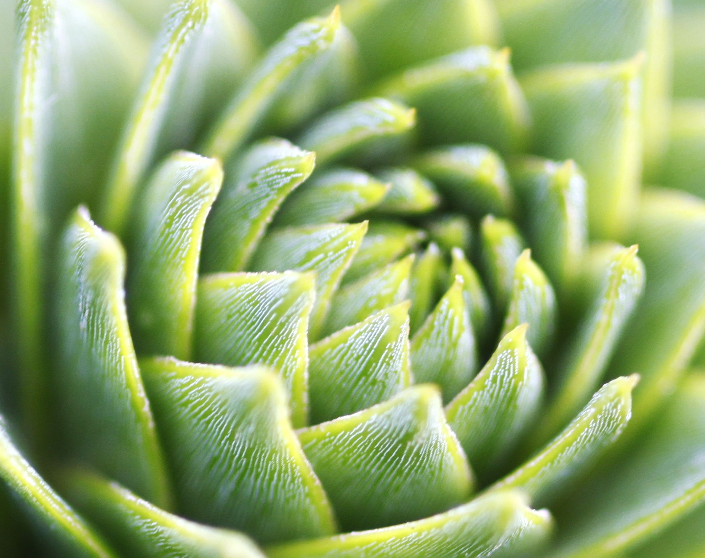
AI-based Plant Disease Identification

Slide 2
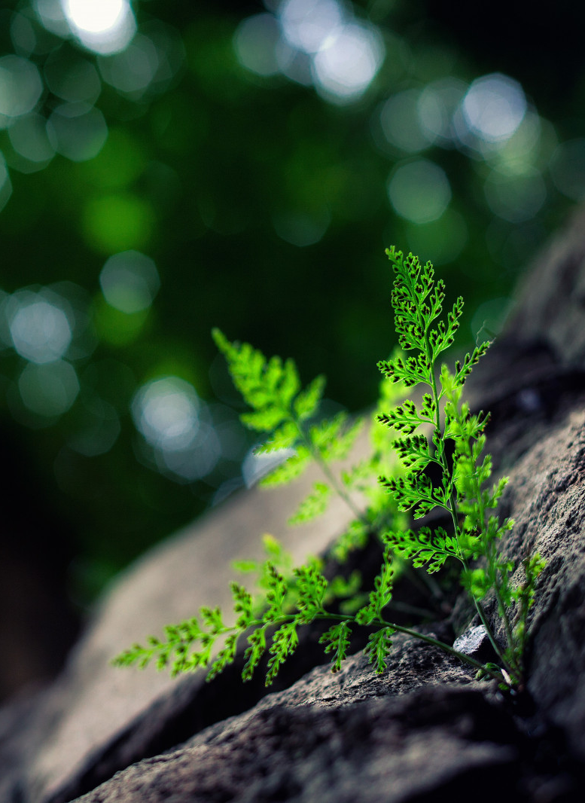
Key Features
Plant disease identification application combines AI and machine learning to identify plant diseases
Advanced algorithms allow the application to differentiate between healthy and diseased plants
Application provides diagnoses and possible cure options
Open AI integration provides human-like interaction between users and the software through natural language processing
Application has enormous potential to revolutionize the field of plant pathology and helping in combat the global problem of crop diseases

Slide 3
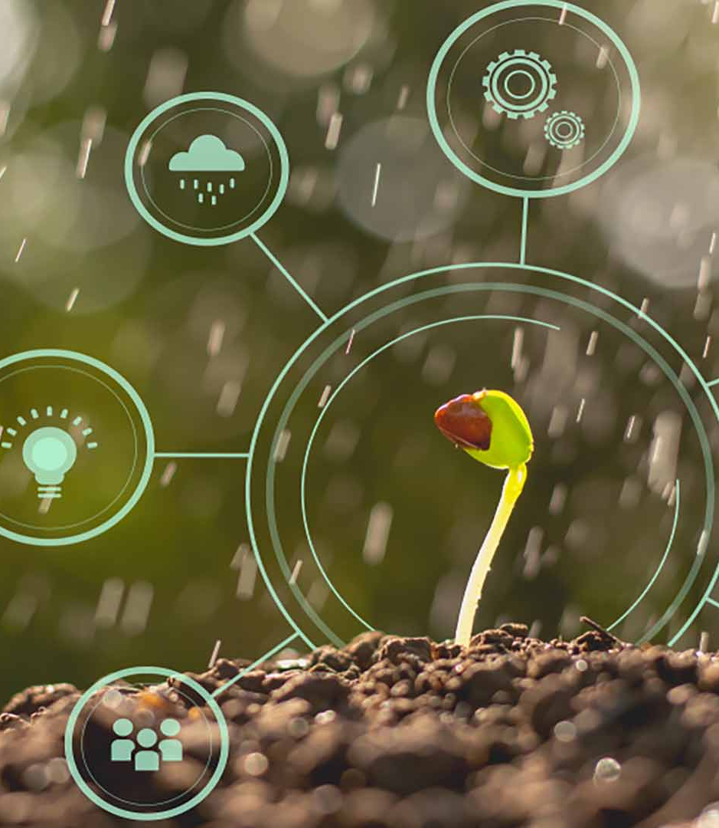
Technical Overview
Computer vision and machine learning are used to identify plant diseases.
When a user takes a photo of a plant leaf using the application, the image is processed through a neural network that has been trained on a large dataset of diseased and healthy plant images.
Once the image has been processed, the neural network outputs a prediction of the disease on the plant, along with a confidence score.
The application also uses an open AI platform to provide natural language processing (NLP) capabilities, which allows users to interact with it using human-like language.
This NLP functionality uses a combination of machine learning algorithms and linguistic analysis to provide users with the most relevant information to the question asked, making the user interface more user-friendly and intuitive.

Slide 4
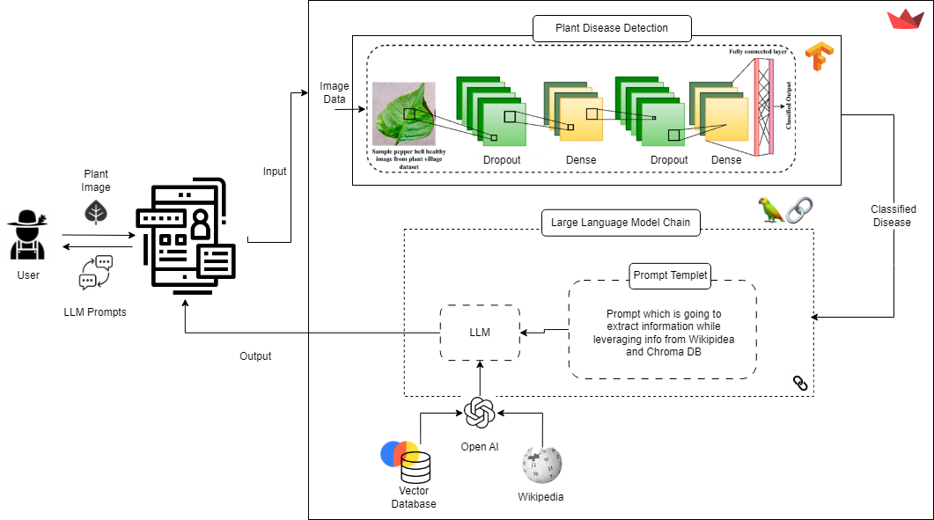
Application Architecture

Slide 5
Demo

Slide 6
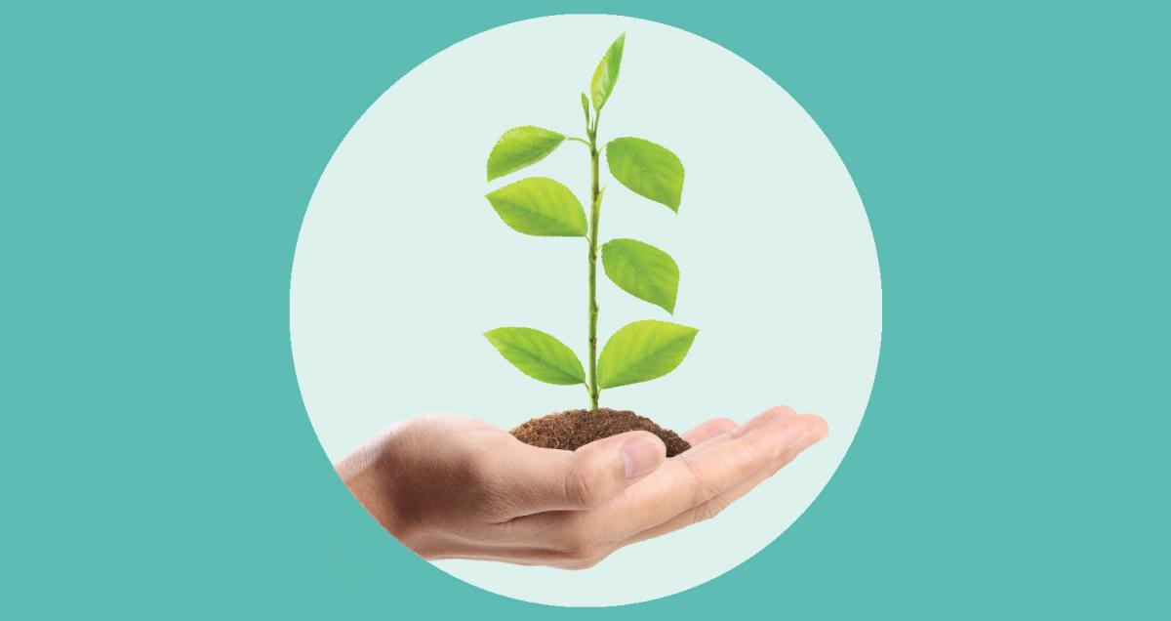
How it helps ?
The application can help farmers and growers quickly identify diseases in their crops, leading to a cost-effective solution and saving crops.
The technology provides accurate identification so that farmers do not have to remove any healthy plants, saving cost, time and other resources.
It can also help home gardeners to identify and treat plant diseases before they get too severe, thereby improving their garden's health.
A more efficient and effective disease identification process can lead to better crop yields and healthier plants overall, leading to better business and environmental outcomes.
The application's user-friendly interface makes it accessible to people with no prior expertise in plant disease identification.

Slide 7
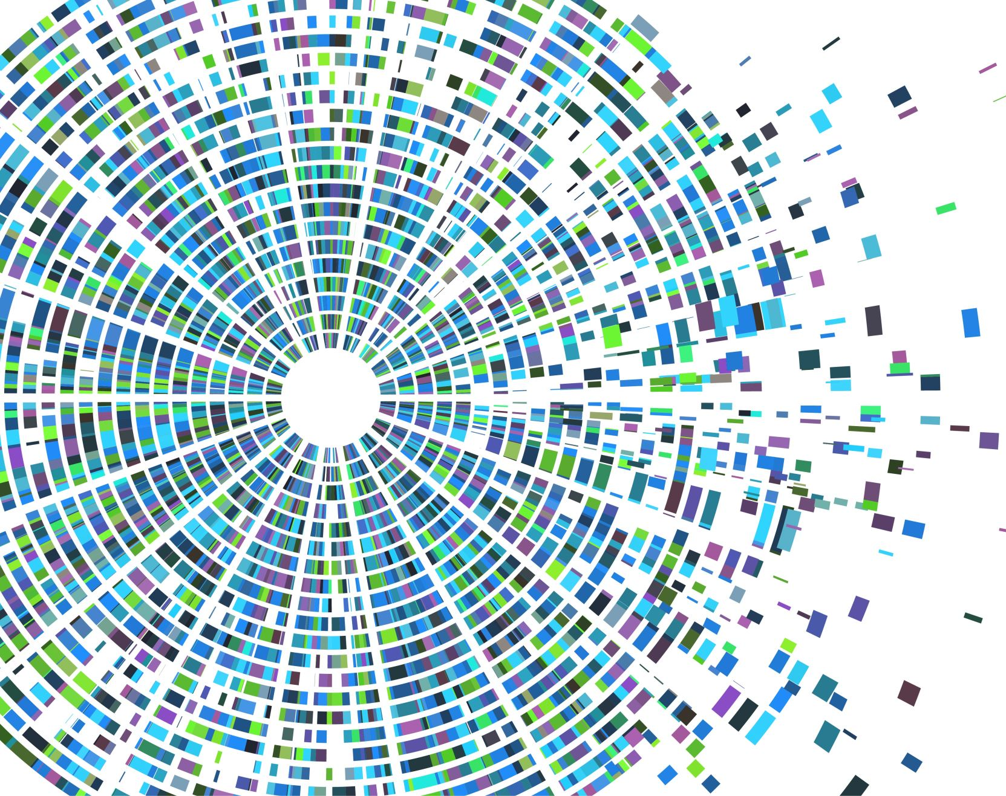
Future Scope

Slide 8
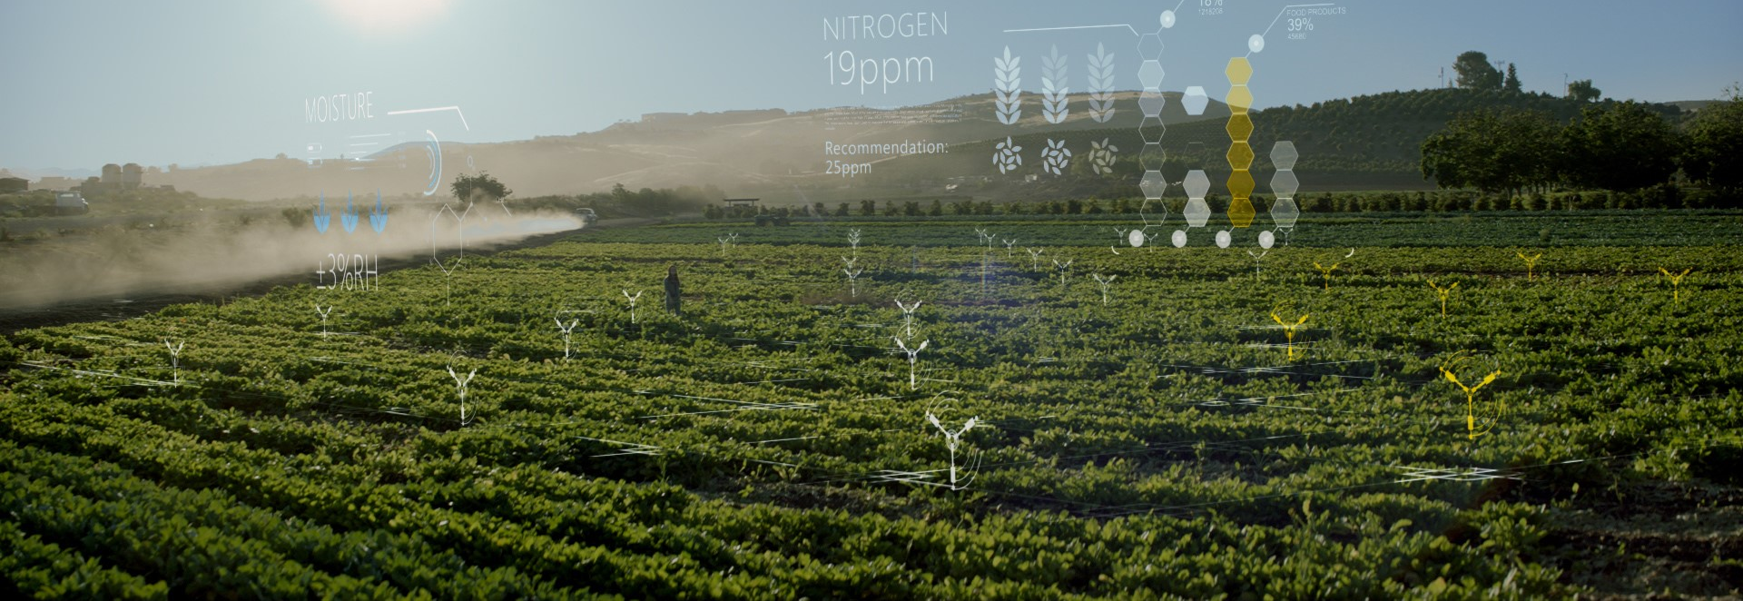
Thank You

